Slide 1
The Android Software Stack
Android stack has five layers:
Linux Kernel
Libraries
Application Framework
Applications
Android Runtime

Slide 2
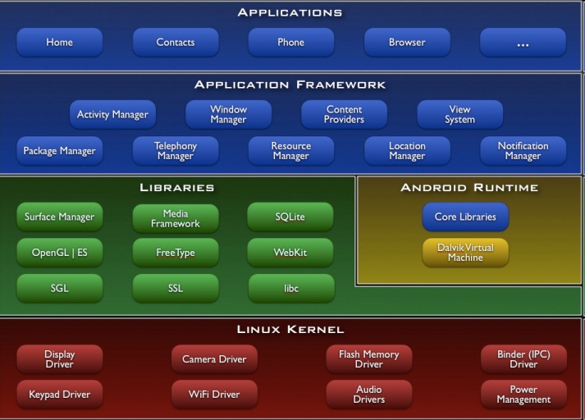
The Android Software Stack

Slide 3
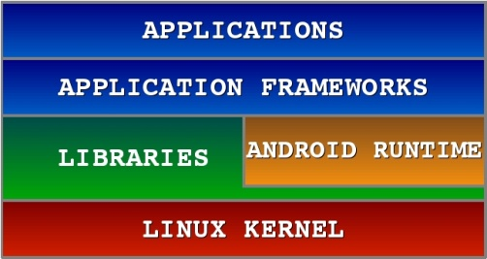
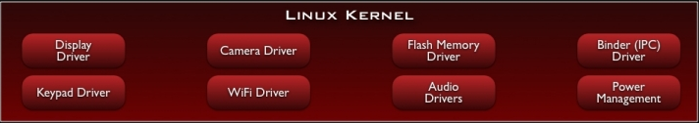
Android S/W Stack – Linux Kernel
It is the heart of android architecture that exists at the root of android architecture.
Linux kernel is responsible for device drivers, power management, memory management, device management and resource access.
The supplied device drivers include Display, Camera, Keypad, WiFi, Flash Memory, Audio, and IPC
Providing an abstraction layer between the H/W and the rest of the S/W stack

Slide 4
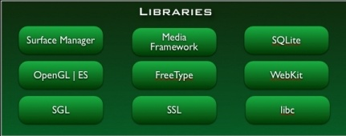
Android S/W Stack - Libraries
On the top of linux kernel, their are Native libraries such as WebKit, OpenGL, FreeType, SQLite, Media, C runtime library (libc) etc.
The WebKit library is responsible for browser support, SQLite is for database, FreeType for font support, Media for playing and recording audio and video formats.

Slide 5
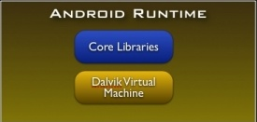
Android S/W Stack - Runtime
Core Libraries
Providing most of the functionality available in the core libraries of the Java language
APIs
Data Structures
Utilities
File Access
Network Access
Graphics, etc

Slide 6
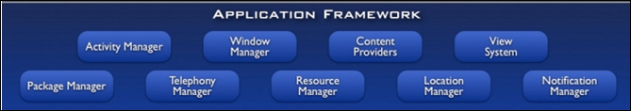
Android S/W Stack – Application Framework
On the top of Native libraries and android runtime, there is android framework.
Android framework includes Android API's such as UI (User Interface), telephony, resources, locations, Content Providers (data) and package managers.
It provides a lot of classes and interfaces for android application development.

Slide 7

Android S/W Stack - Application
Android provides a set of core applications:
Email Client
SMS Program
Calendar
Maps
Browser
Contacts

Slide 8
Dalvik Virtual Machine | DVM
The Dalvik Virtual Machine (DVM) is an android virtual machine optimized for mobile devices.
It optimizes the virtual machine for memory, battery life and performance.
Dalvik is a name of a town in Iceland.
The Dex compiler converts the class files into the .dex file that run on the Dalvik VM. Multiple class files are converted into one dex file.

Slide 9
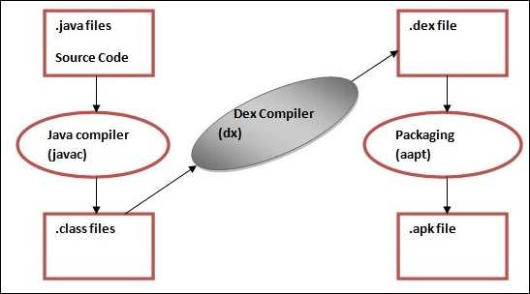
Android S/W Stack – Runtime (Cont)
The Dalvik Virtual Machine (DVM) is an android virtual machine optimized for mobile devices.
The Dex compiler converts the class files into the .dex file that run on the Dalvik VM. Multiple class files are converted into one dex file.

Slide 10
Android S/W Stack – Runtime (Cont)
The javac tool compiles the java source file into the class file.
The dx tool takes all the class files of your application and generates a single .dex file. It is a platform-specific tool.
The Android Assets Packaging Tool (aapt) handles the packaging process.

Slide 11
App Manifest
Every Android app must include an AndroidManifest.xml file
The Android Manifest is an XML file which contains important metadata about the Android app.
This includes the package name, activity names, main activity (the entry point to the app), Android version support, hardware features support, permissions, and other configurations.

Slide 12
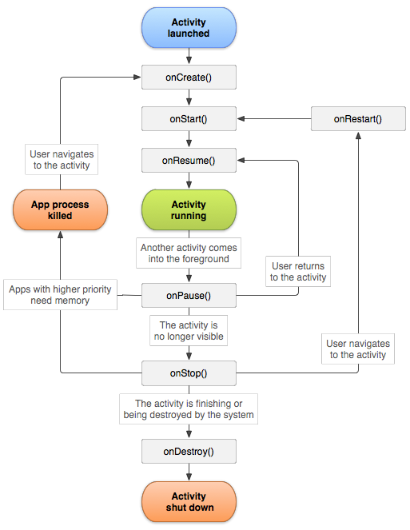
Activity Lifecycle

Slide 13
Activity Lifecycle
When you run your android application, Activity goes through different states and the following callback methods are called by system.
onCreate(): Called when the activity is first created. You can write the code for initializing the control/view.
onStart(): This method is called when the activity becomes visible to the user.
onResume(): It is called when the activity starts interacting with the user.
onPause(): It is called when the current activity is being paused and the previous activity is being resumed. Activity is not destroyed, but it is invisible.
onStop(): It is called when the activity is stopped and not visible to the user.
onDestroy(): It is called before the activity is destroyed by the system call.
onRestart(): It is called when the activity has been stopped and is restarting again.

Slide 14
Android Toast
Android Toast can be used to display information for the short period of time.
A toast contains message to be displayed quickly and disappears after sometime.
The android.widget.Toast class is the subclass of java.lang.Object class.
Toast.makeText(getApplicationContext(),”Mesage",Toast.LENGTH_SHORT).show();

Slide 15
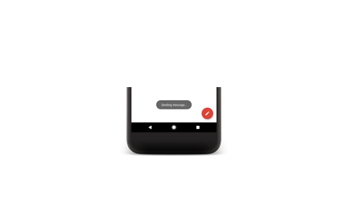
Toasts overview
A toast provides simple feedback about an operation in a small popup. It only fills the amount of space required for the message and the current activity remains visible and interactive. Toasts automatically disappear after a timeout.
For example, clicking Send on an email triggers a "Sending message..." toast, as shown in the following screen capture:

Slide 16
Example of Toast
package example.shubha.com.toast;
import android.support.v7.app.AppCompatActivity;
import android.os.Bundle;
import android.widget.Toast;
public class MainActivity extends AppCompatActivity {
@Override
protected void onCreate(Bundle savedInstanceState) {
super.onCreate(savedInstanceState);
setContentView(R.layout.activity_main);
//Displaying Toast with Hello Javatpoint message
Toast.makeText(getApplicationContext(),"Hello BMSCE",Toast.LENGTH_SHORT).show();
}
}

